Slide 1
Statistical Analysis Presentation
Based on Health Survey for England 2011

Slide 2
Alcohol in the UK
56.9% survey respondents 16+ in Great Britain drank alcohol in 2016. (Windsor-Shellard, 2017)
Alcohol consumption is associated with the brain health. (Topiwala et al., 2015)
Since licensing is the primary legislative instrument for regulation in retail, then public health considerations should play a role in this process. (Nicholls, 2015)

Slide 3

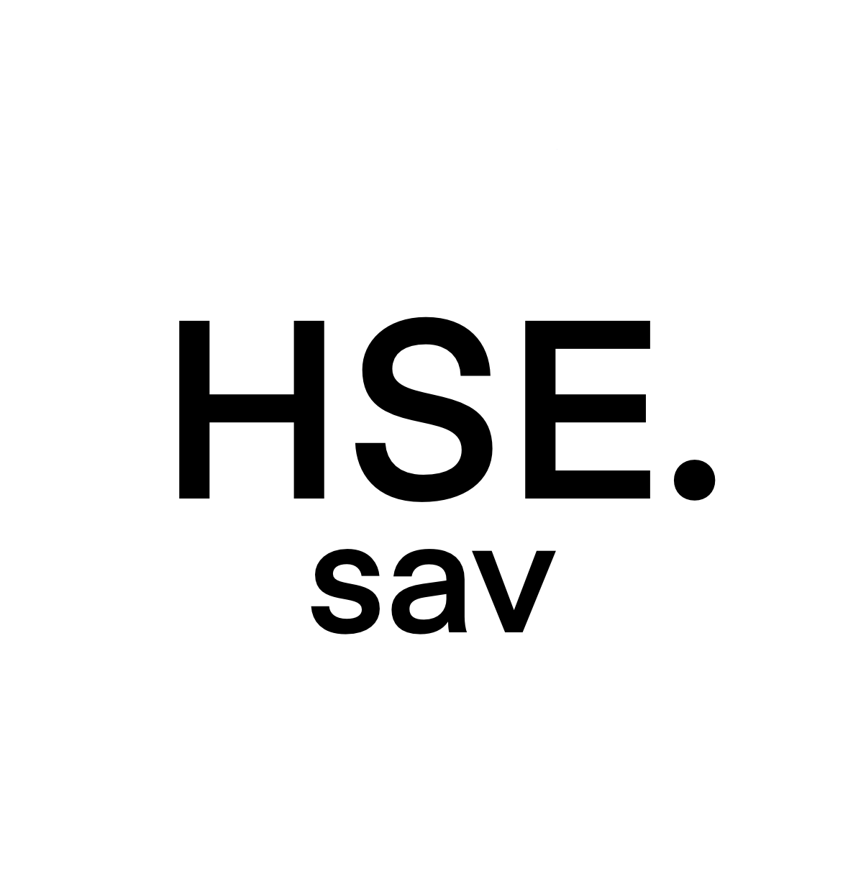
The presentation equation
Descriptive statistics
and
Inferential statistics
+
+
RStudio
Health Survey
for England
2011

Slide 4
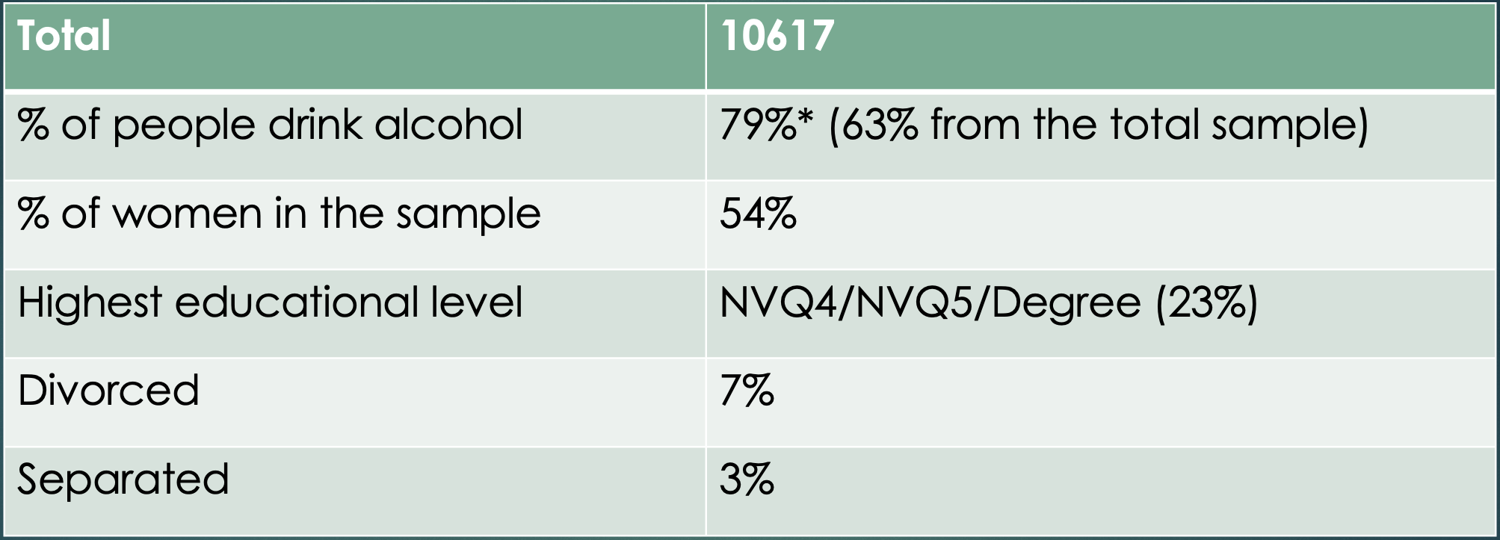
Descriptive Statistics 1
*among responders who answered “yes” or “no” to alcohol consumption question

Slide 5
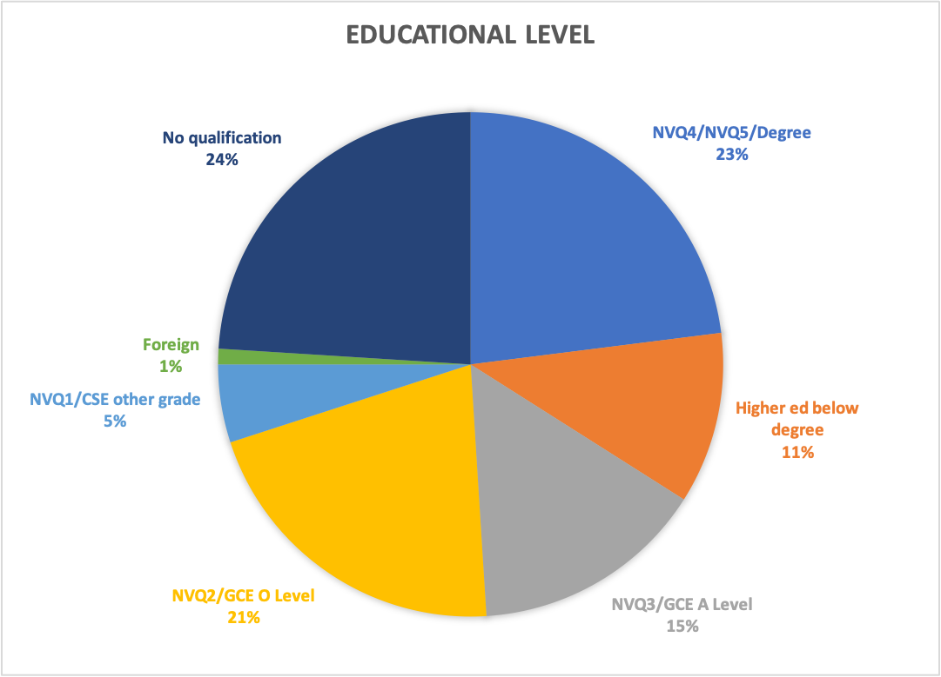
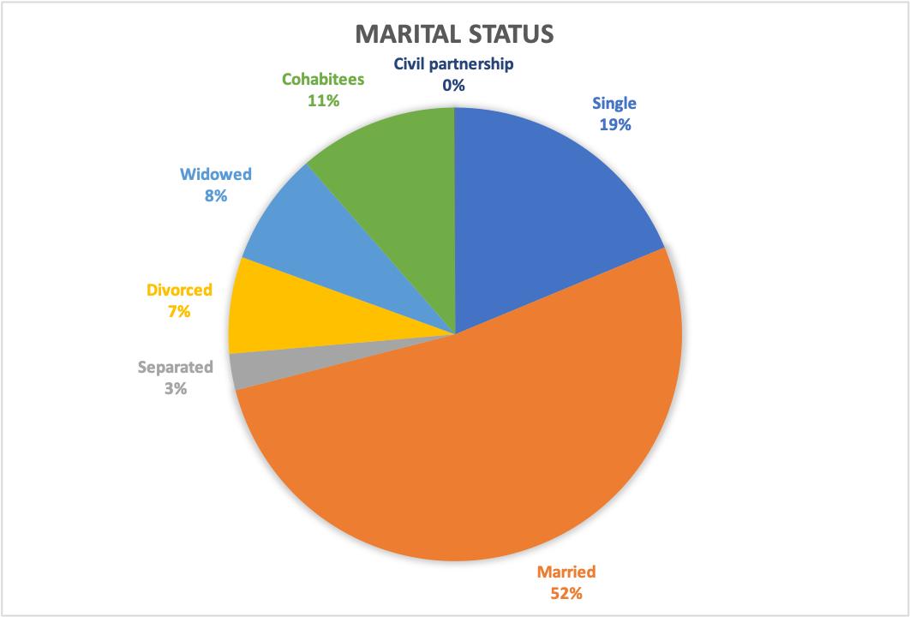
Educational level and Marital Status

Slide 6
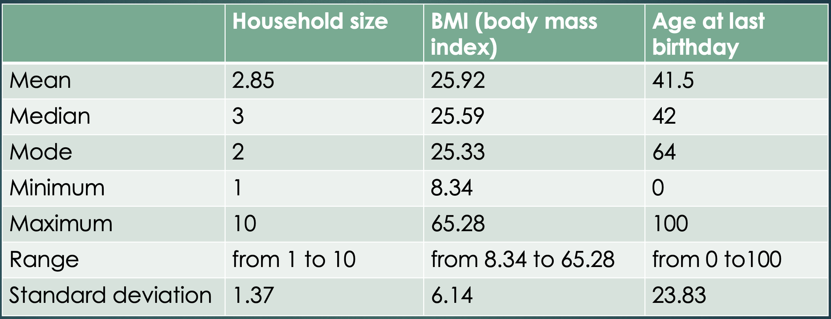
Descriptive Statistics 2

Slide 7
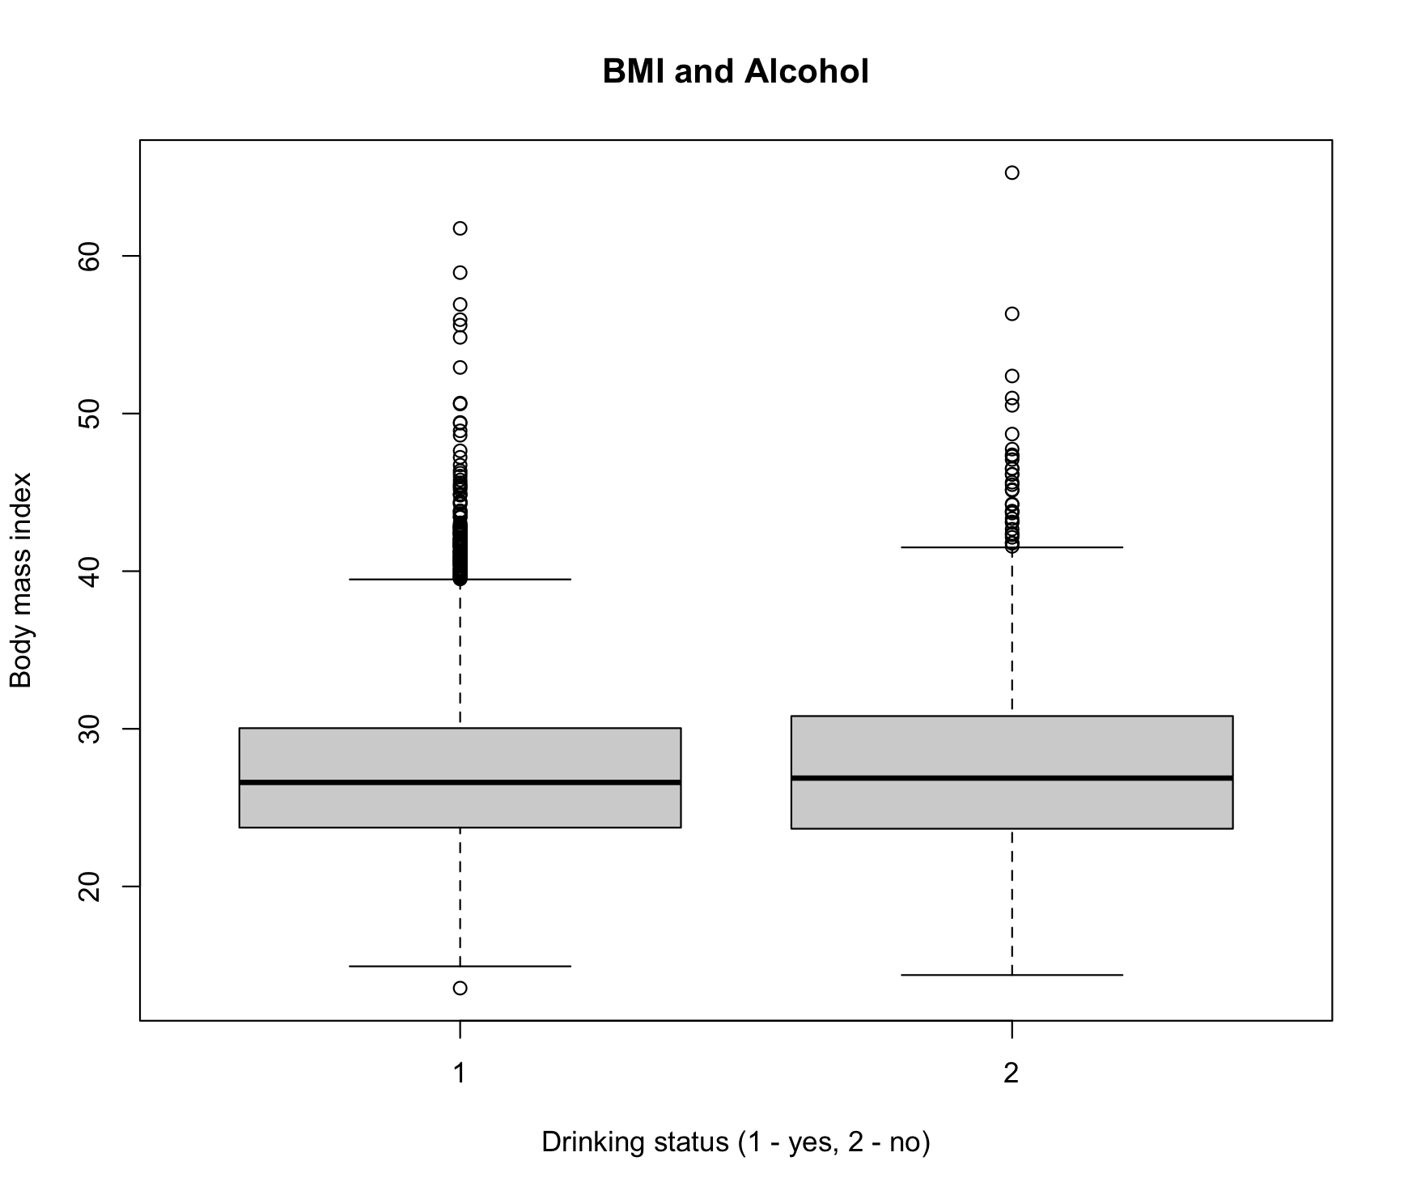
BMI means
There is a tiny difference in BMI means between “drinkers”(27.31) and ”abstainers” (27.77) groups.*
*among responders who answered “yes” or “no” to alcohol consumption question

Slide 8
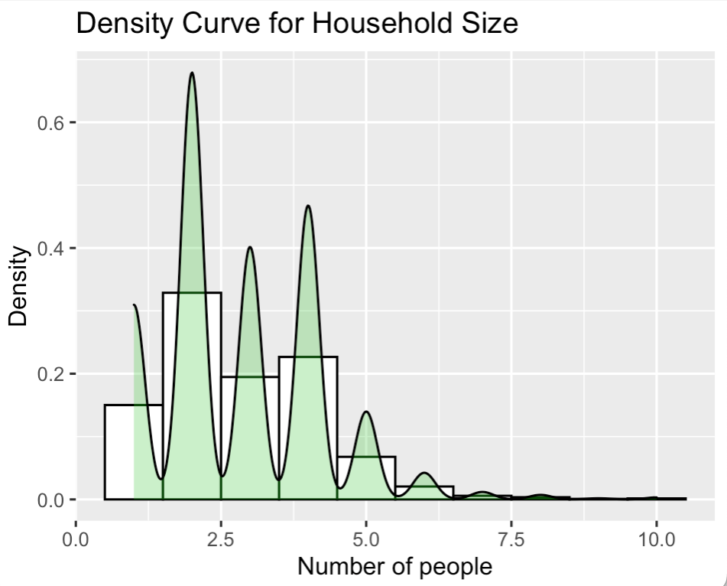
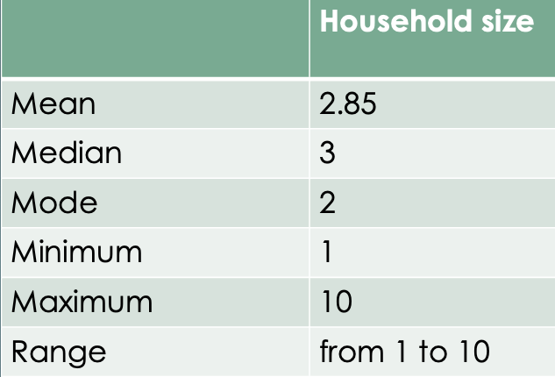
Household Size with ggplot2

Slide 9
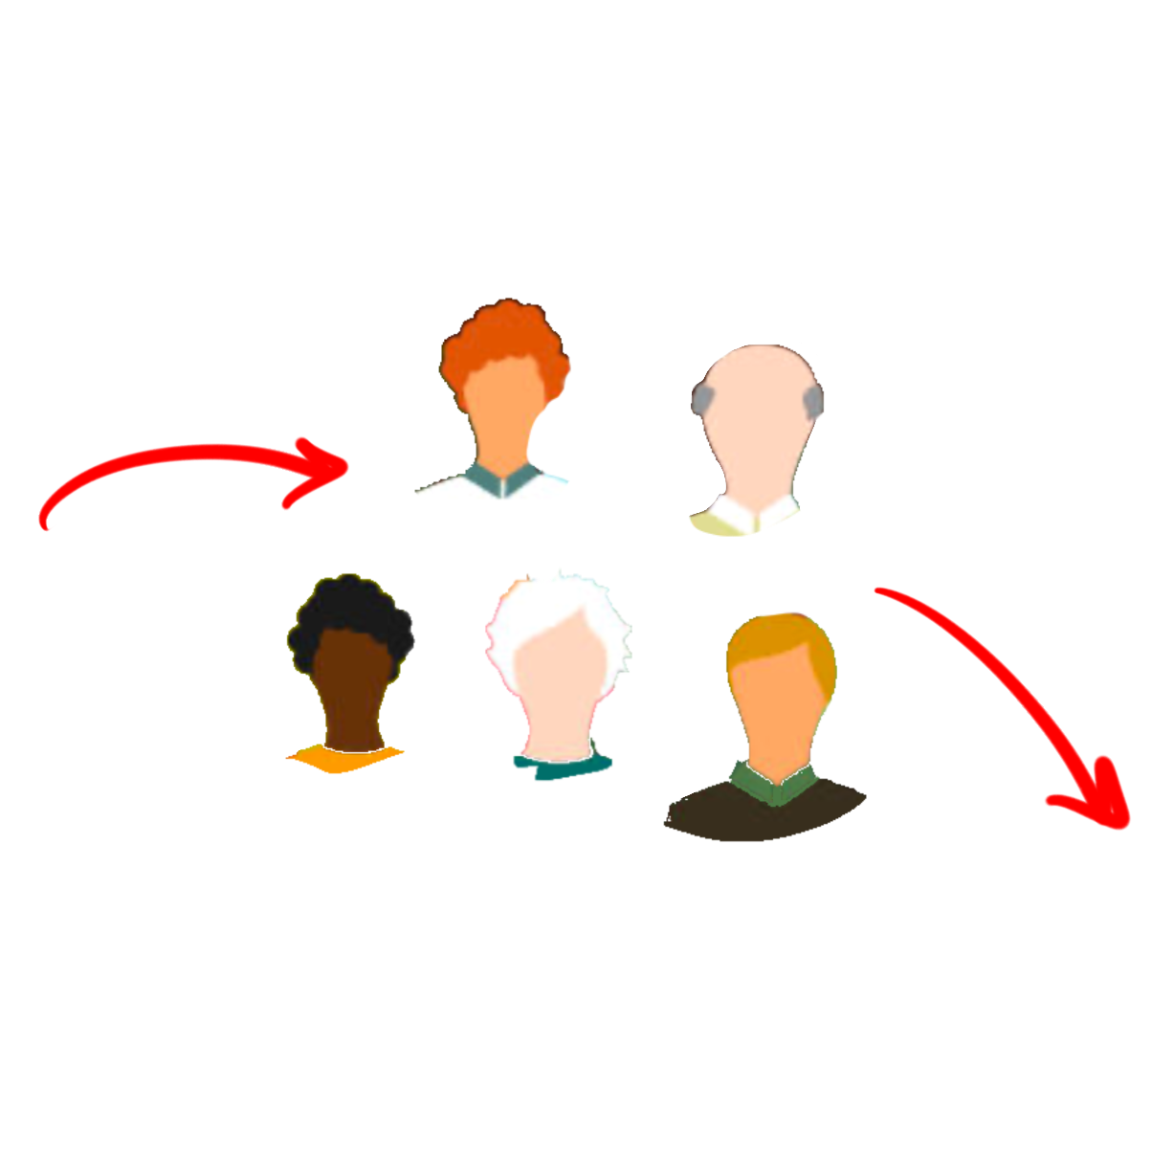
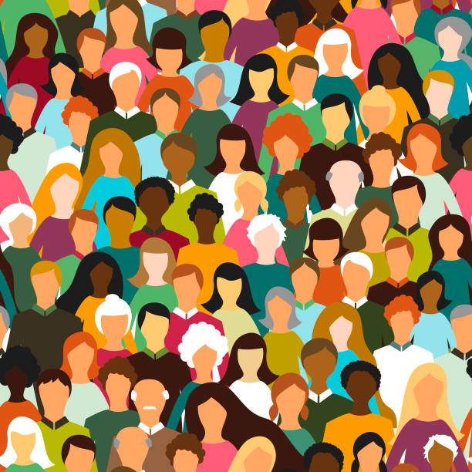
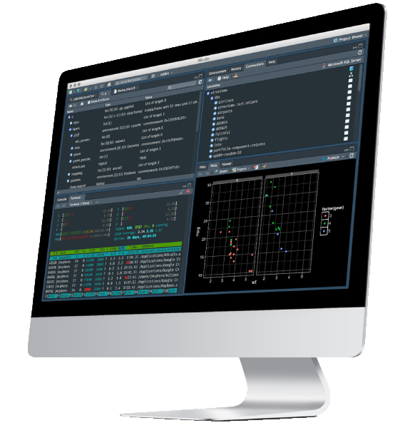
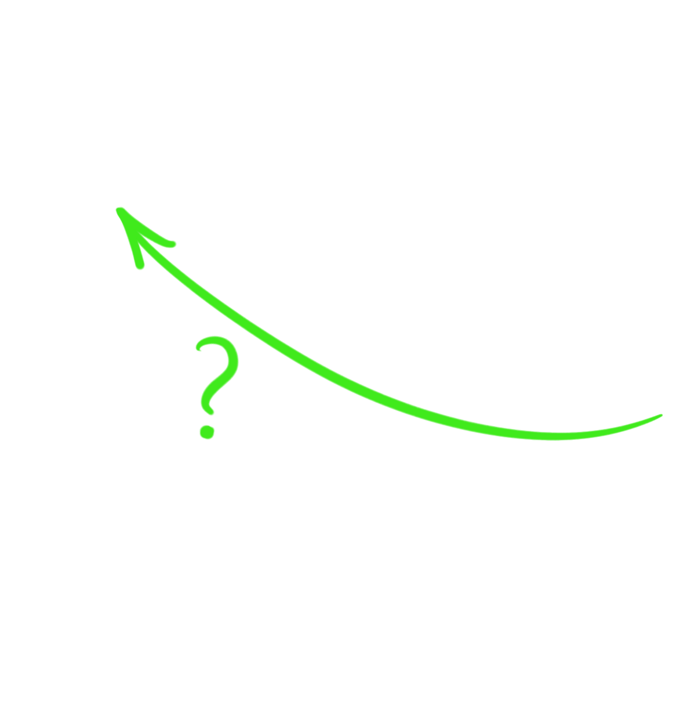
Inferential Statistics
Sample
Population
Inferential Statistics uses probabilistic techniques to analyze sample data from a population to improve knowledge about the whole population.
(Asadoorian & Kantarelis, 2005)

Slide 10
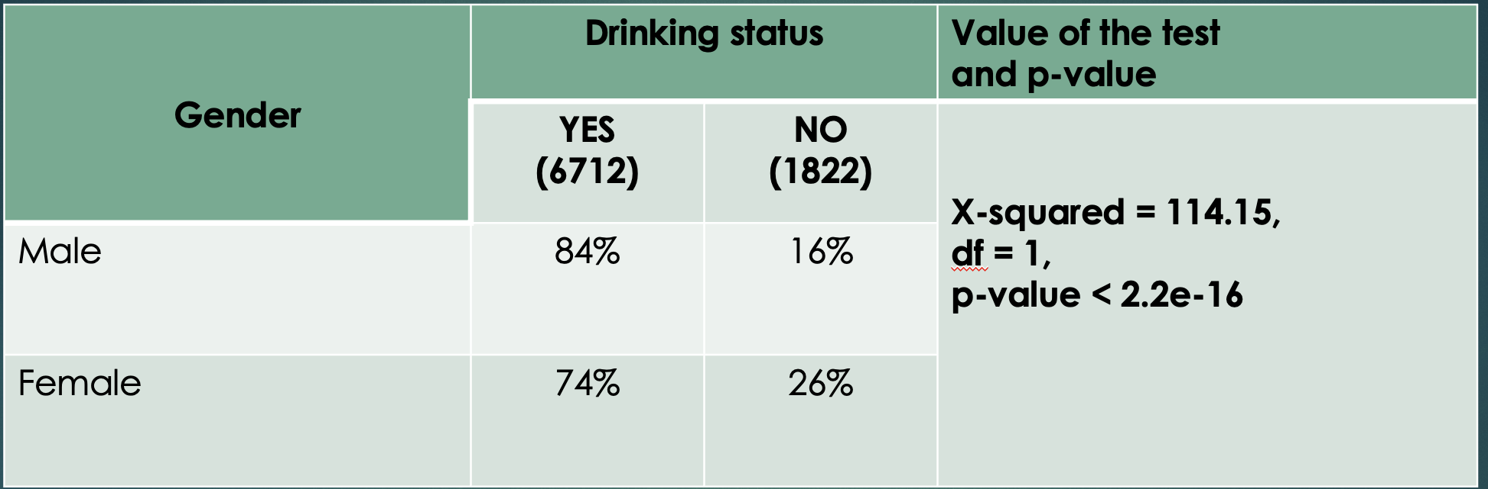
Alcohol and gender
Null hypothesis: There is NO association between gender and alcohol, alpha = 0.05.
Chi-square test shows p-value is less than threshold 0.05,
we can reject the null hypothesis.
There is an association between gender and drinking alcohol.

Slide 11
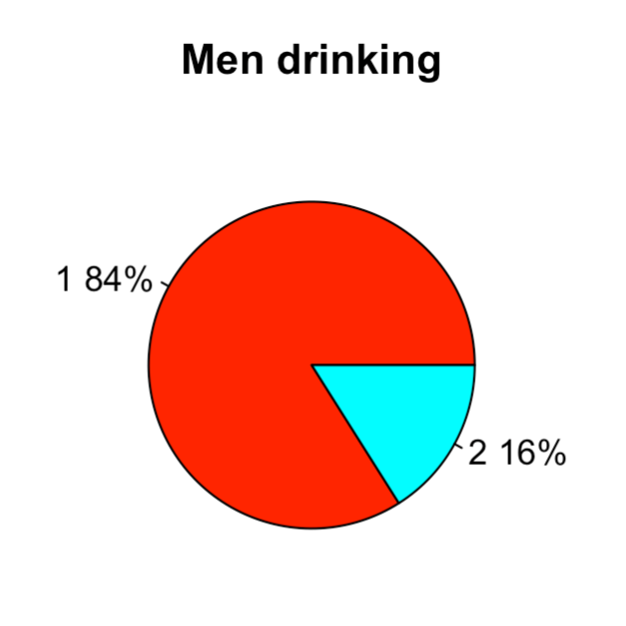
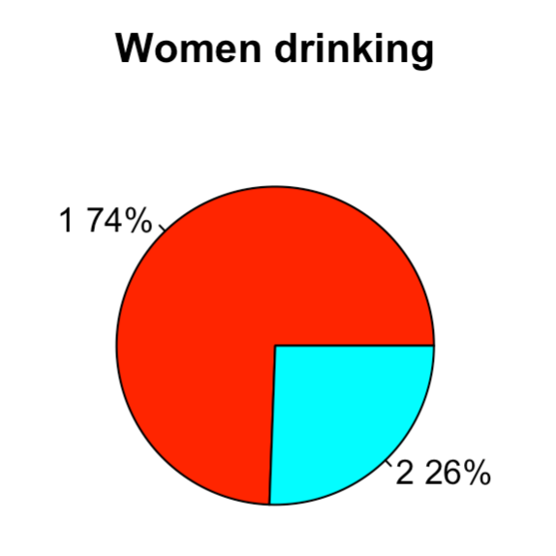
Gender difference in alcohol consumption (1 – “drink”, 2 – “don’t drink”)

Slide 12
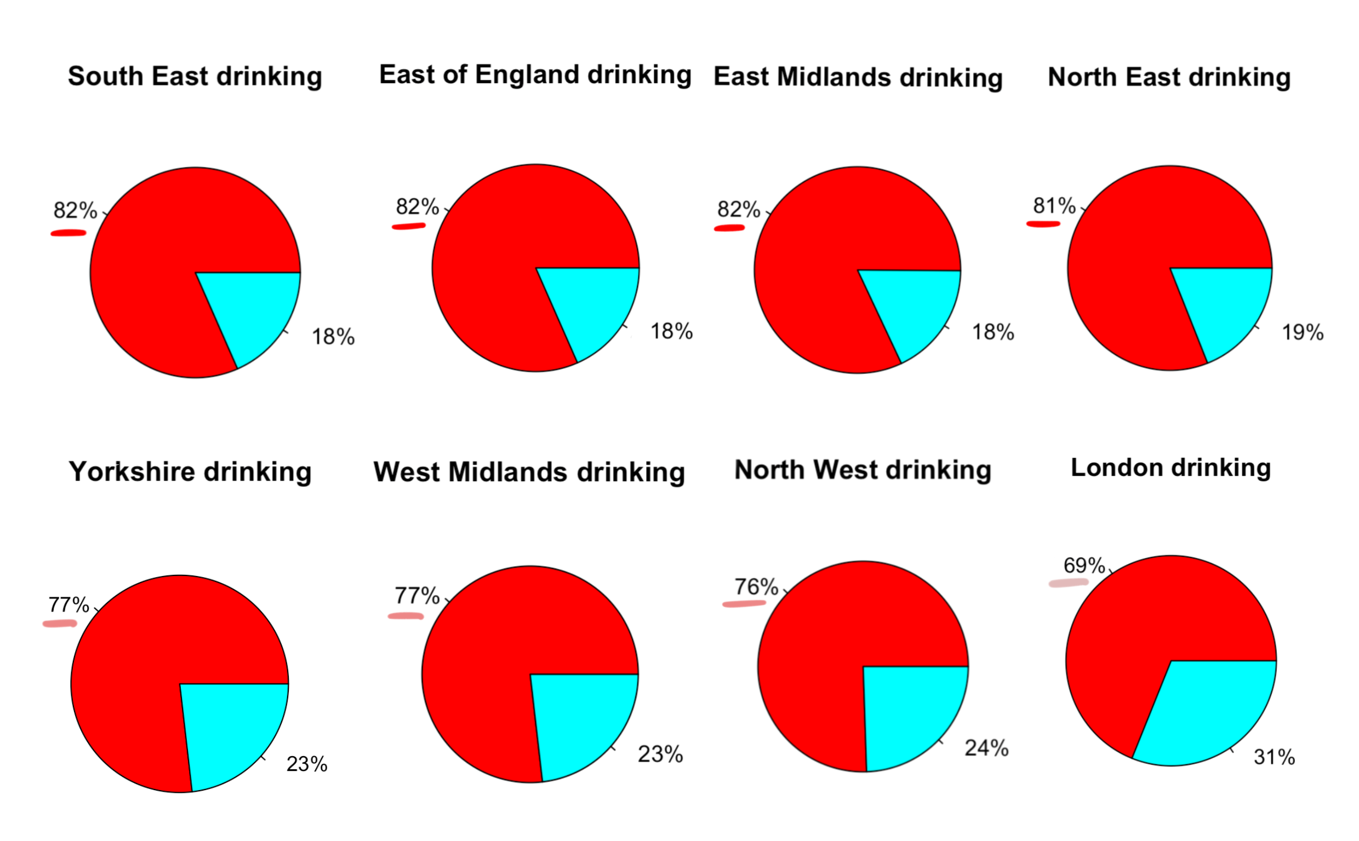
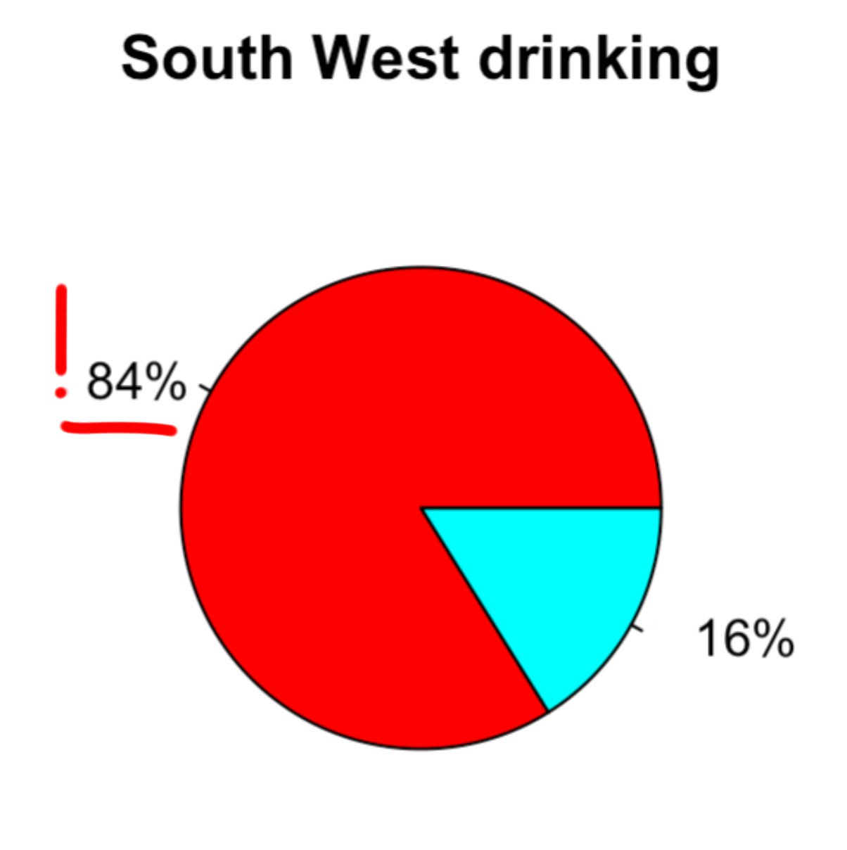
Alcohol and region
* Red color means drinking

Slide 13
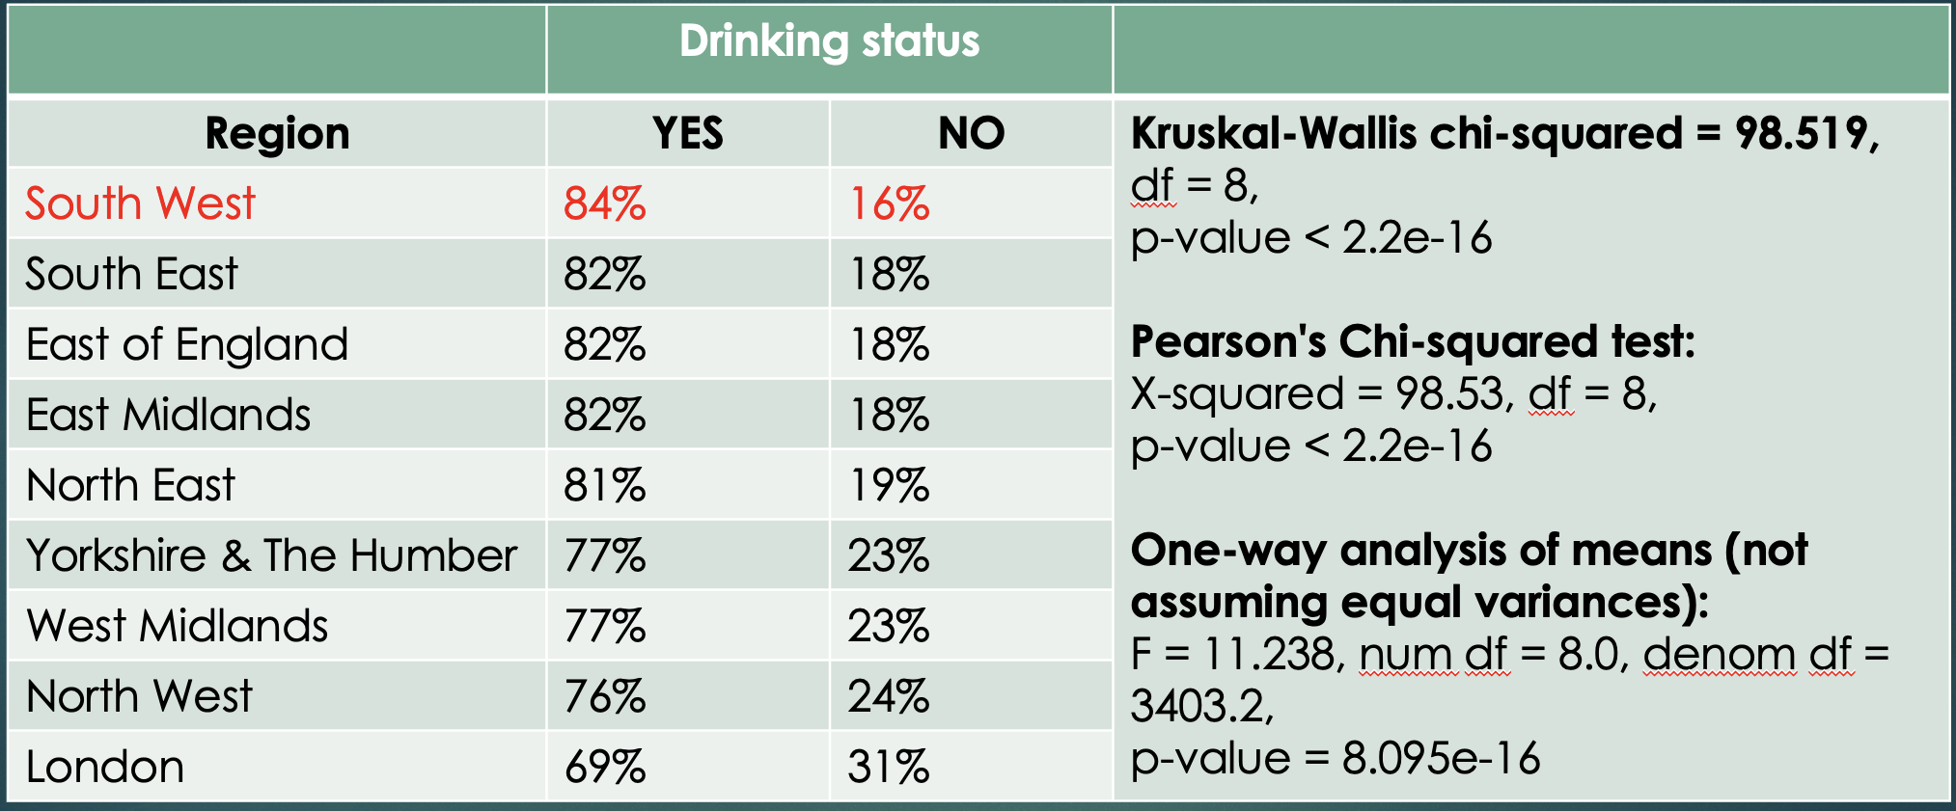
Alcohol and region
There is an association between region and drinking alcohol.

Slide 14
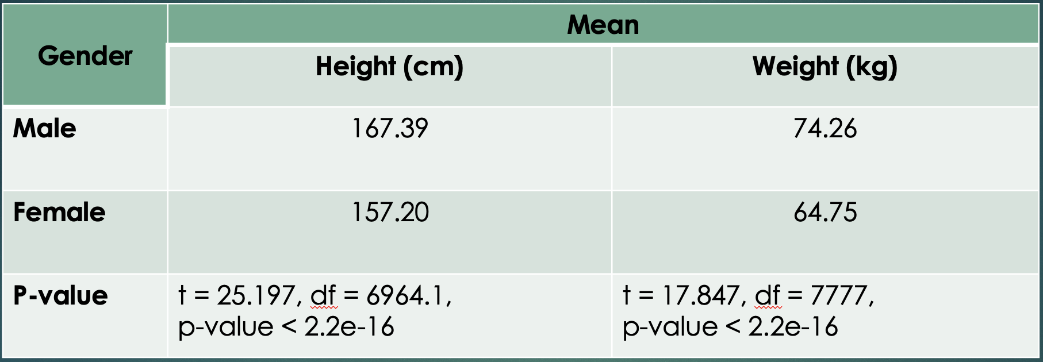
Height and weight
Two Sample t-test for both pairs of variables.
Null hypothesis: two groups have equal means.
According to the p-value < 0.05 we reject the null hypothesis.
True difference in means between male group and female group is not equal to 0.

Slide 15
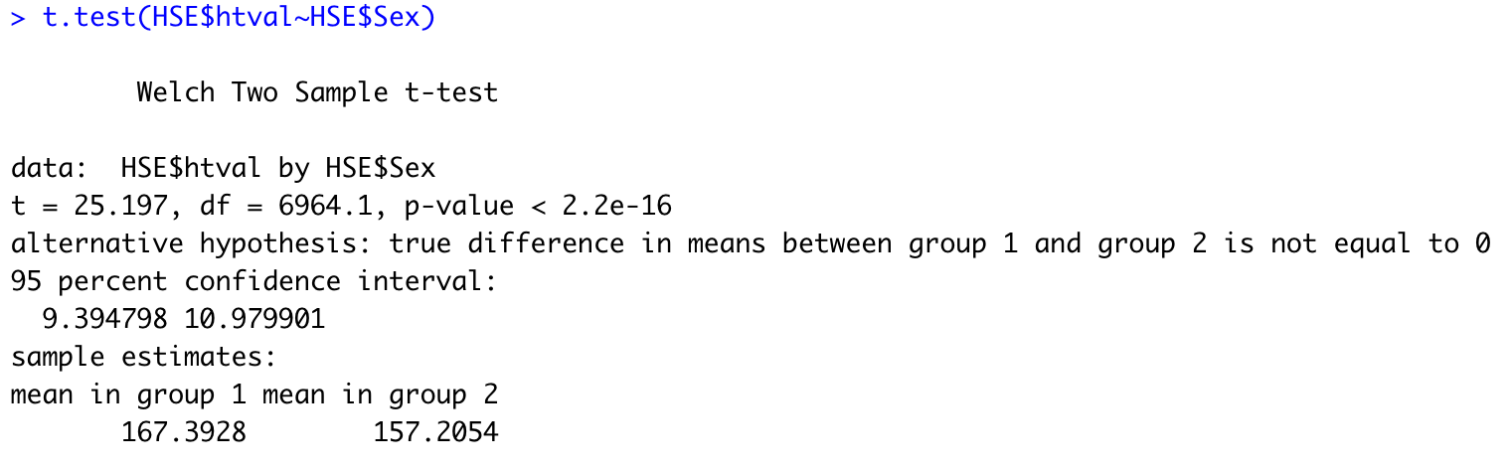
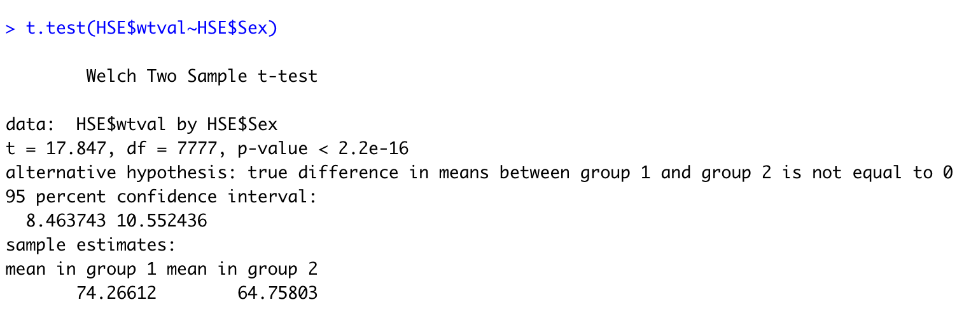
Two-Sample t-test in RStudio
To find the difference between height means in two groups
To find the difference between weight means in two groups

Slide 16
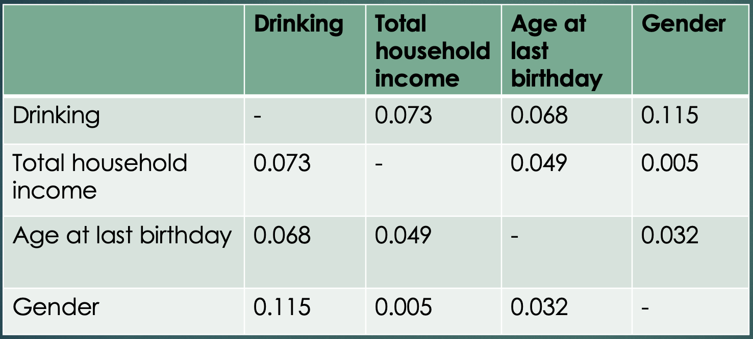
Correlation between drinking, income, age and gender (r)
There is a very weak positive correlation for all variables in the table - hundredths or thousandths of one percent.
For the pair Drinking-Gender positive correlation is about a tenth of a percent.

Slide 17
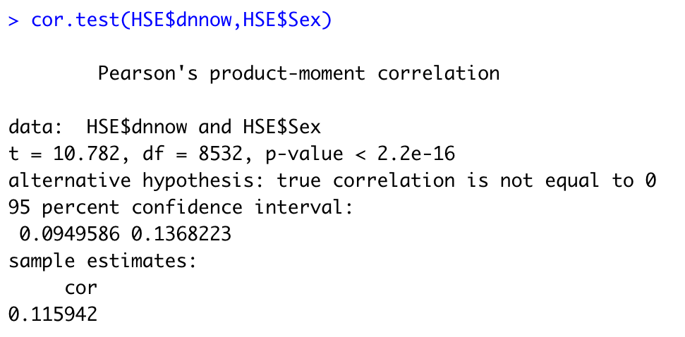
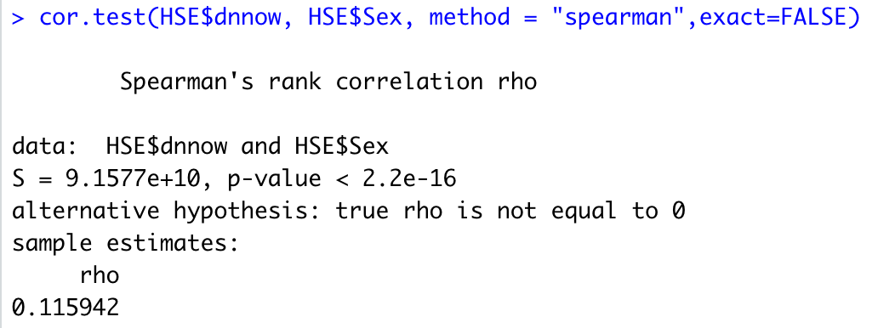
Correlation tests in RStudio

Slide 18
Conclusion: the major findings
There is a difference in BMI means between ”drinkers” and ”abstainers”
People drink the most in South West of England, the least – in London
Men drink more than women

Slide 19
Other studies
Men are more likely to consume alcohol than women are, and it is cross-cultural phenomenon. (Wilsnack et al., 2009)
In UK males are perceived to drink more than females. (Dempster, 2011)
There are some associations between occupations and heavy alcohol consumption. (Thompson & Pirmohamed, 2021)

Slide 20
Appendix

Slide 21
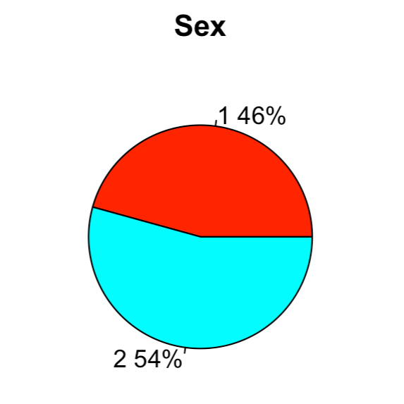
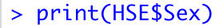
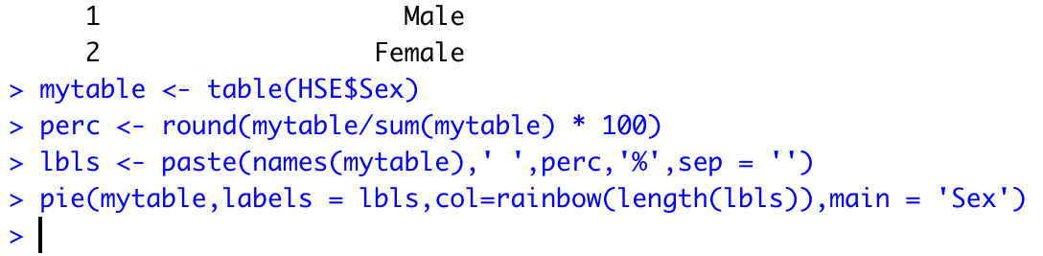
Creating a pie chart with percentage in RStudio
To get info on gender in the dataset:
To create the pie chart:
* the same way for HSE$topqual3 (Educational level) and HSE$marstatc (Marital status)

Slide 22
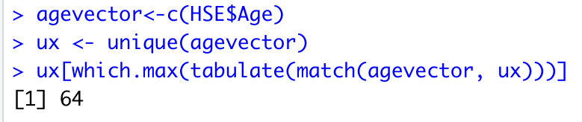
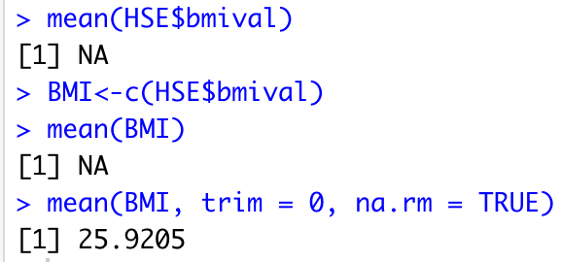
Find Mode/Mean/Median in RStudio
Example of the code to find the mode in RStudio:
In case you are unable to return any value other than NA for mean/median:

Slide 23
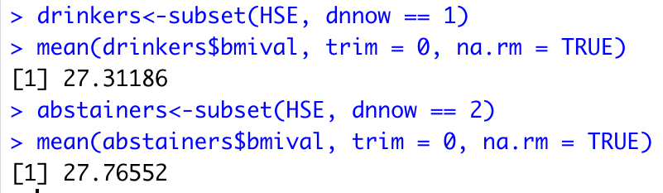
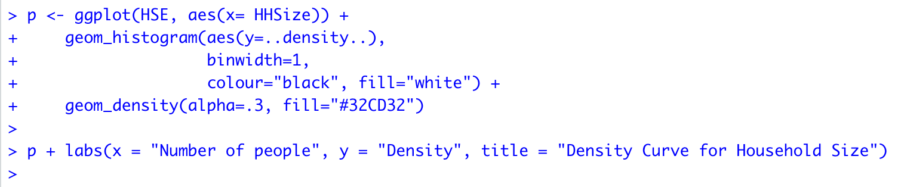
Boxplot and ggplot in RStudio
For BMI and drinking status:
To find the difference in means:
To find household size density:

Slide 24
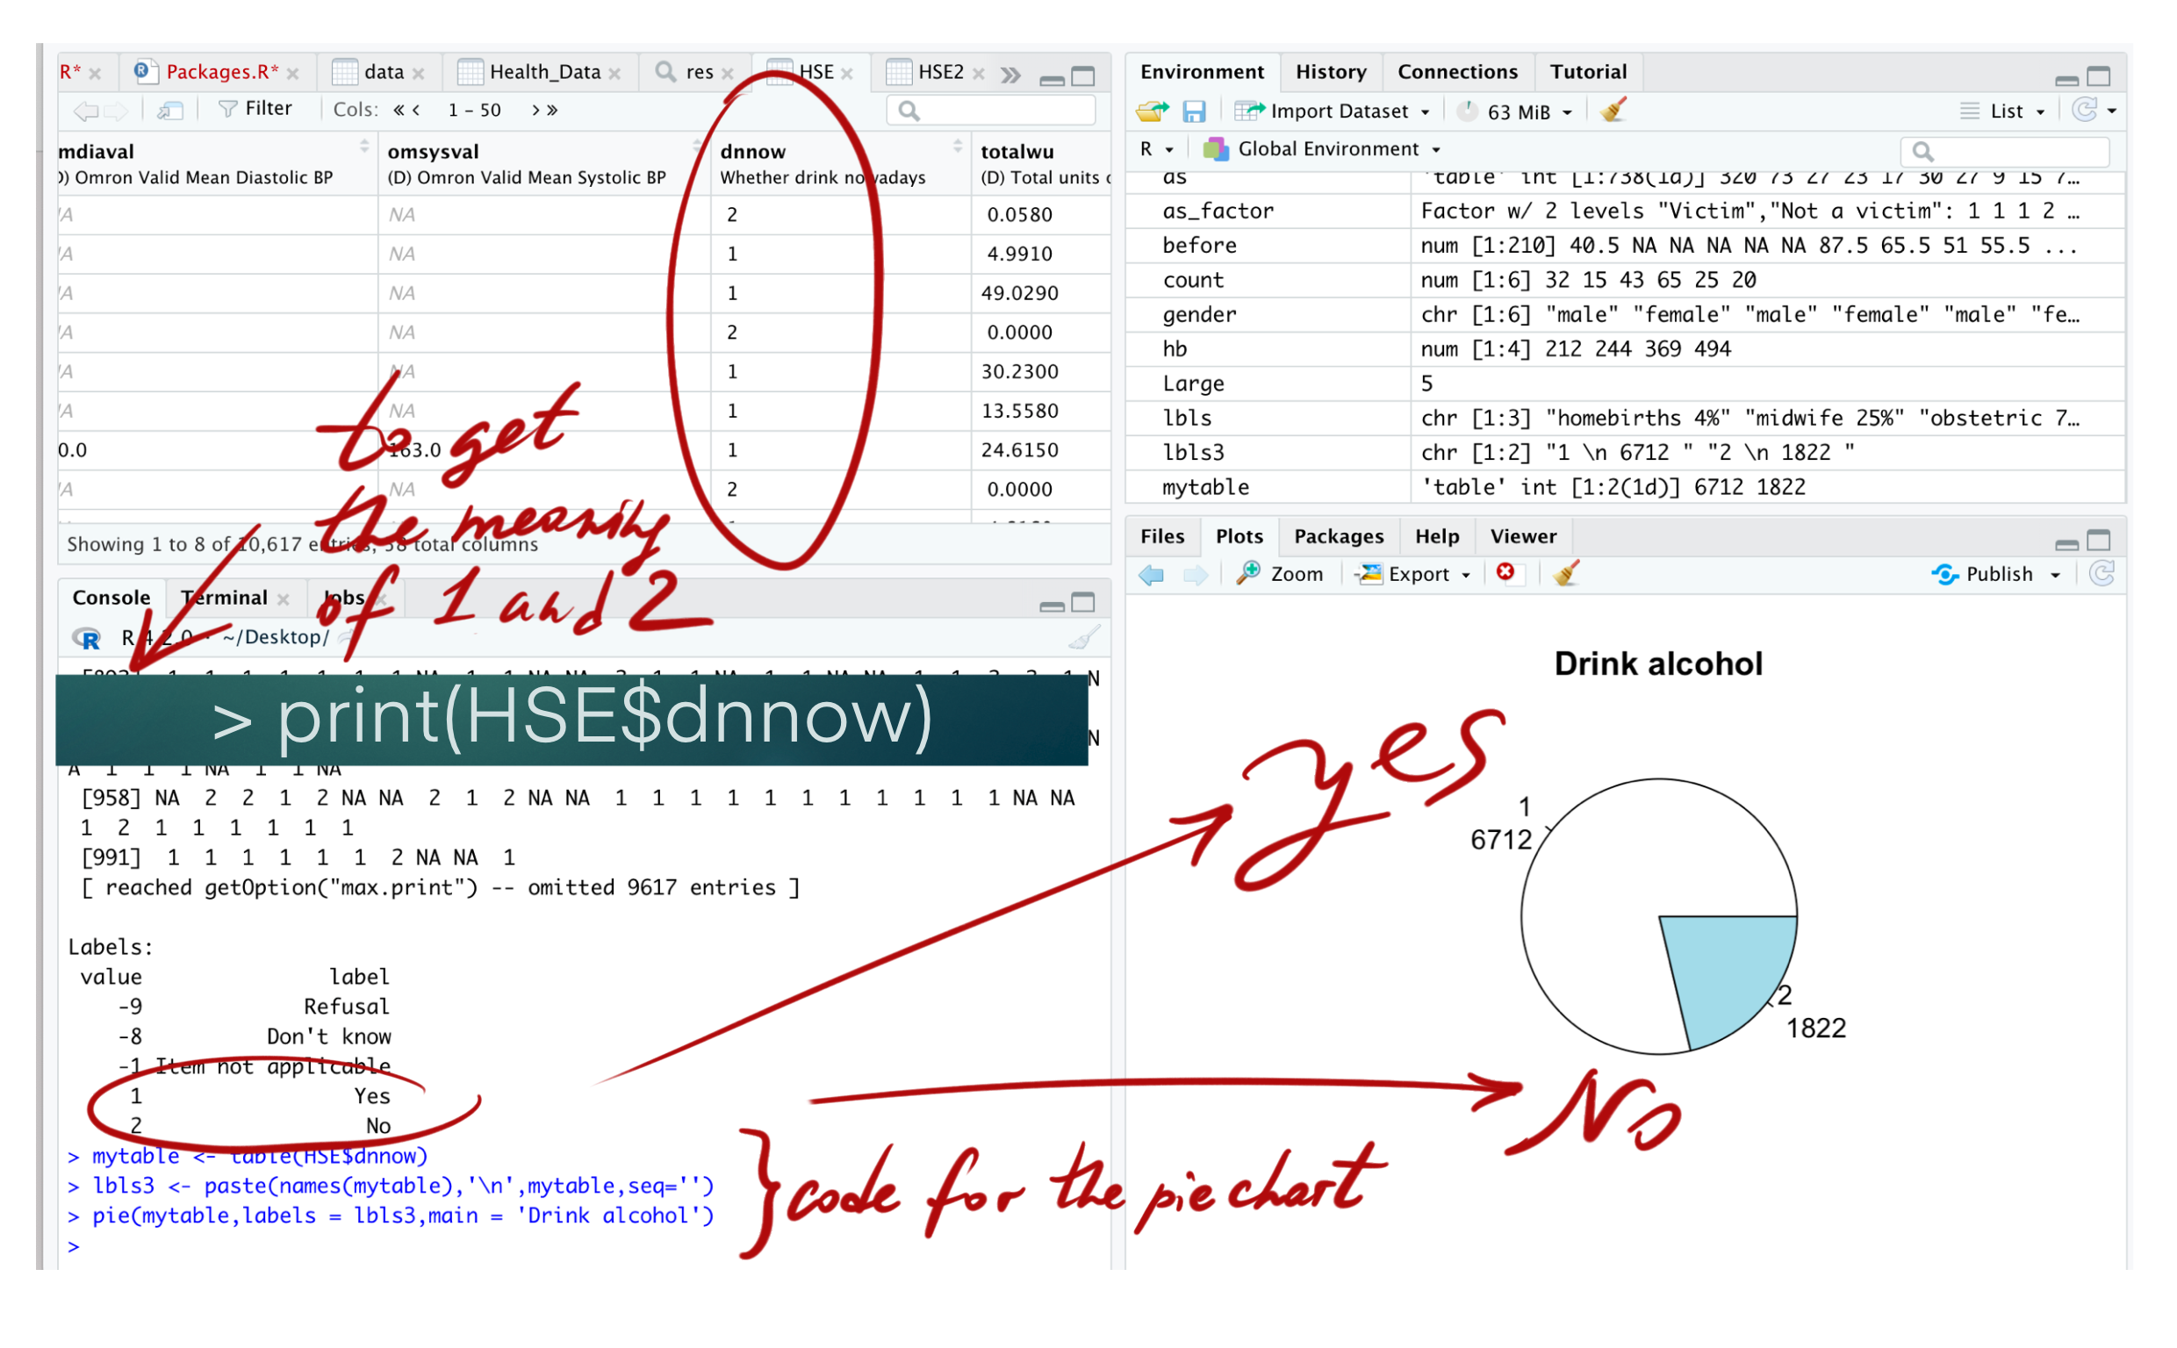
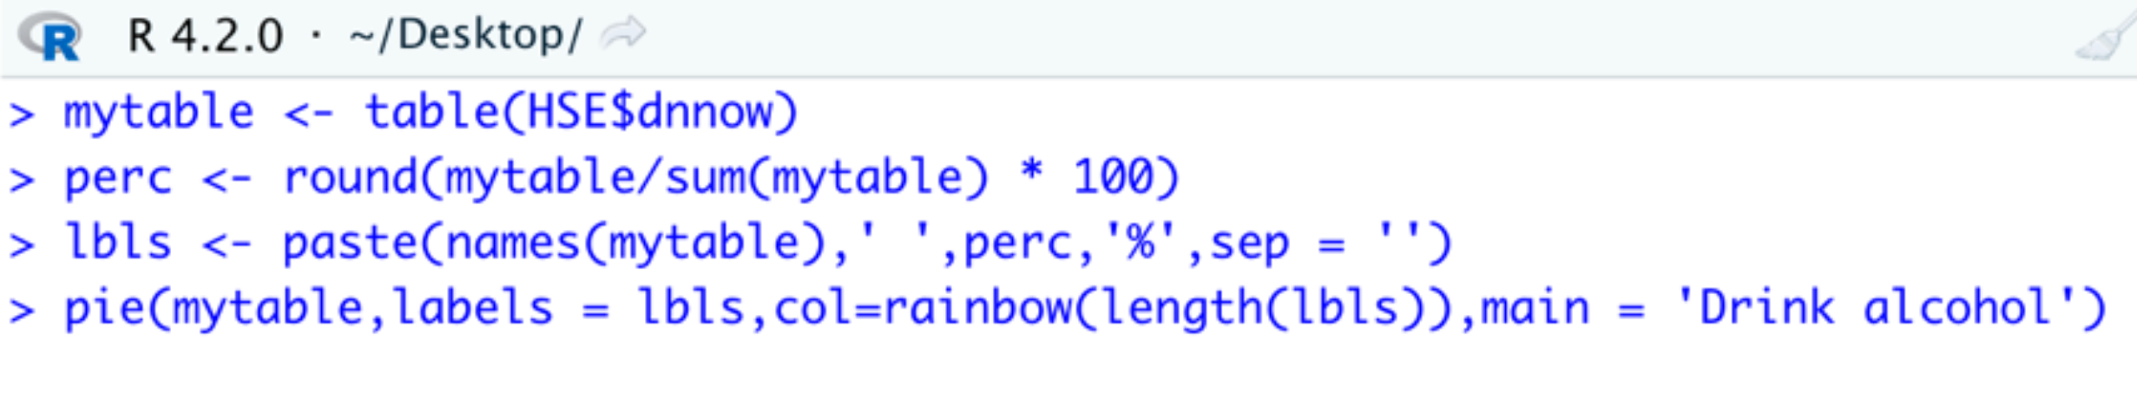
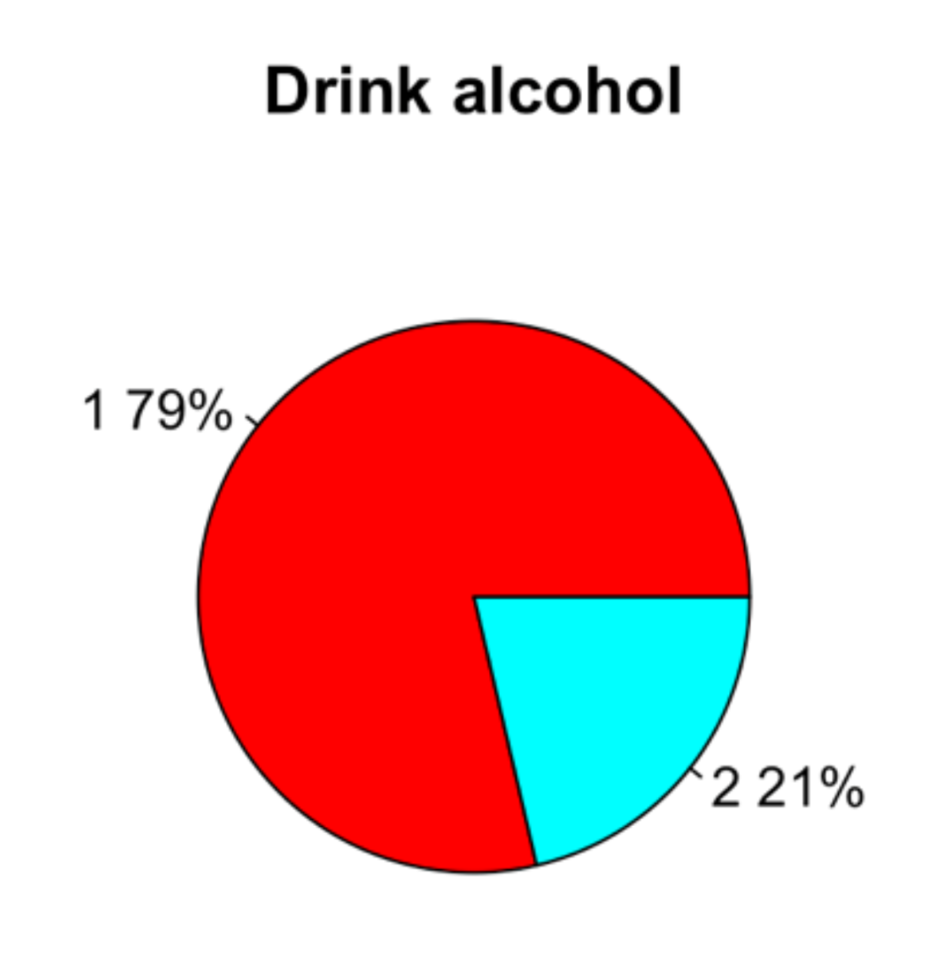
Creating a pie chart for ”drinking alcohol” variable in RStudio

Slide 25
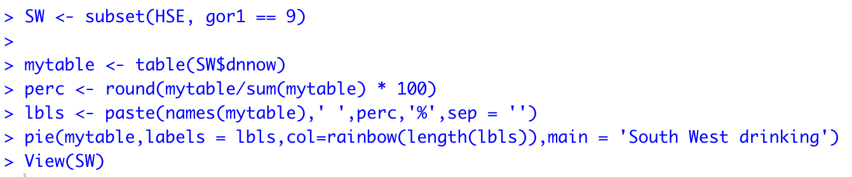
Code example of “drinking” pie chart with percentage for the each region in RStudio

Slide 26
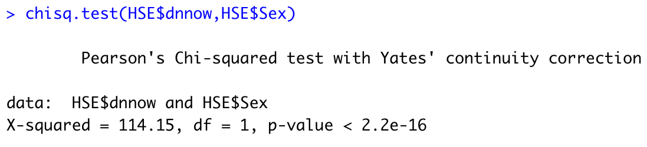
Chi-squared test in RStudio for gender and drinking

Slide 27
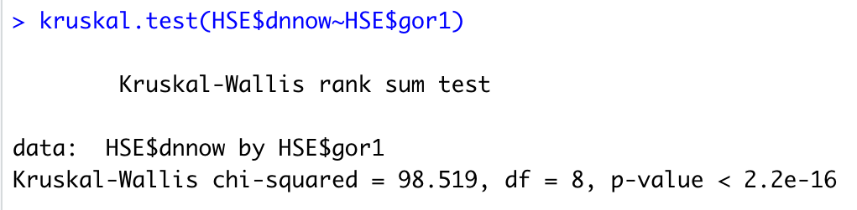
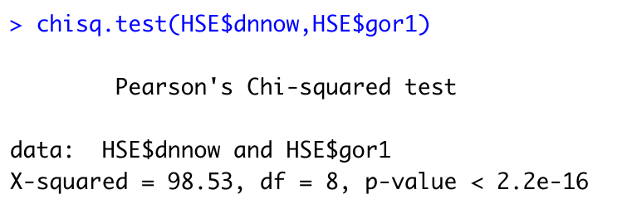
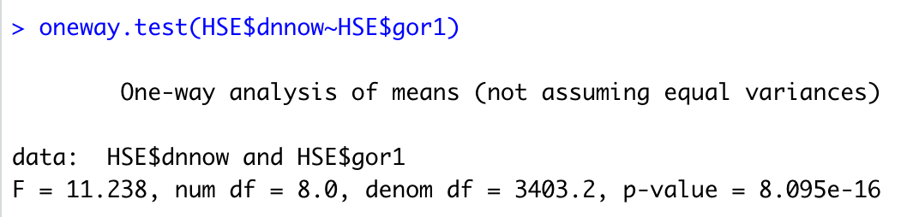
Tests for region and drinking in RStudio

Slide 28
References:
Health Survey for England - 2011, Health, social care and lifestyles N (2012) HS Digital. Available from: https://digital.nhs.uk/data-and-information/publications/statistical/health-survey-for-england/health-survey-for-england-2011-health-social-care-and-lifestyles [Accessed 25 August 2022]
Windsor-Shellard, B. (2017) Adult drinking habits in Great Britain: 2005 to 2016. The Office for National Statistics. Available from: https://www.ons.gov.uk/peoplepopulationandcommunity/healthandsocialcare/drugusealcoholandsmoking/bulletins/opinionsandlifestylesurveyadultdrinkinghabitsingreatbritain/2005to2016#:~:text=1.-,Main%20points,million%20people%20in%20the%20population [Accessed 25 August 2022]
Topiwala, A., Ebmeier, K.P., Maullin-Sapey, T. and Nichols, T.E. (2021) No safe level of alcohol consumption for brain health: observational cohort study of 25,378 UK Biobank participants. medRxiv.
Nicholls, J. (2015) Public health and alcohol licensing in the UK: challenges, opportunities, and implications for policy and practice. Contemporary Drug Problems, 42(2), pp.87-105.
Nick, T.G. (2007) Descriptive Statistics. In: Ambrosius, W.T. (eds) Topics in Biostatistics. Methods in Molecular Biology™, vol 404. Humana Press. https://doi.org/10.1007/978-1-59745-530-5_3
Asadoorian, M. O. & Kantarelis, D. (2005) Essentials of Inferential Statistics. University Press of America.
Gonzalez-Chica, D. et al. (2015). Test of association: which one is the most appropriate for my study? An Bras Dermatol. Jul-Aug; 90(4): 523–528.
Keselman, H.J., Othman, A.R., Wilcox, R.R. & Fradette, K., (2004). The new and improved two-sample t test. Psychological Science, 15(1), pp.47-51.
Wilsnack R.W., Wilsnack S.C., Kristjanson A.F., Vogeltanz-Holm N.D. & Gmel G. (2009) Gender and alcohol consumption: patterns from the multinational GENACIS Project. Addiction. Sep; 104(9): 1487–1500.
Dempster, S. (2011) I drink, therefore I’m man: gender discourses, alcohol and the construction of British undergraduate masculinities. Gender and Education, 23:5, 635-653, DOI: 10.1080/09540253.2010.527824
Thompson, A., & Pirmohamed, M. (2021). Associations between occupation and heavy alcohol consumption in UK adults aged 40–69 years: a cross-sectional study using the UK Biobank. BMC public health, 21(1), 1-12.

